Slide 1
TDD Hands-On <1>
Wei Xiao
June 5, 2015

Slide 2
TDD Cycle
Refactor
Test fails
Test pass

Slide 3
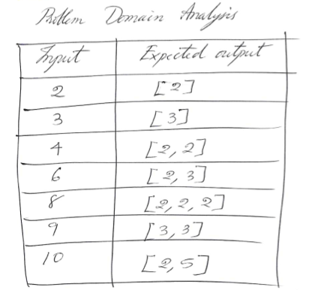
Exercise
Factorize a positive integer number into its prime factors.
找出一个正整数的所有质因数

Slide 4
DEMO
https://vimeo.com/97516288
Start from 32’50

Slide 5
TDD
Starts with confidence
Deals with specific cases then
  Concludes generic cases

Slide 6
Transformation Priority Premise (TPP)
http://blog.8thlight.com/uncle-bob/2013/05/27/TheTransformationPriorityPremise.html
• ({}–>nil) no code at all->code that employs nil
• (nil->constant)
• (constant->constant+) a simple constant to a more complex constant
• (constant->scalar) replacing a constant with a variable or an argument
• (statement->statements) adding more unconditional statements.
• (unconditional->if) splitting the execution path
• (scalar->array)
• (array->container)
• (statement->recursion)
• (if->while)
• (expression->function) replacing an expression with a function or algorithm
• (variable->assignment) replacing the value of a variable.

Slide 7
TDD is design tool or testing tool ??

Slide 8
What scenarios can TDD be used in?
What *Not*?
If *Not*, what do we do?

